Slide 1

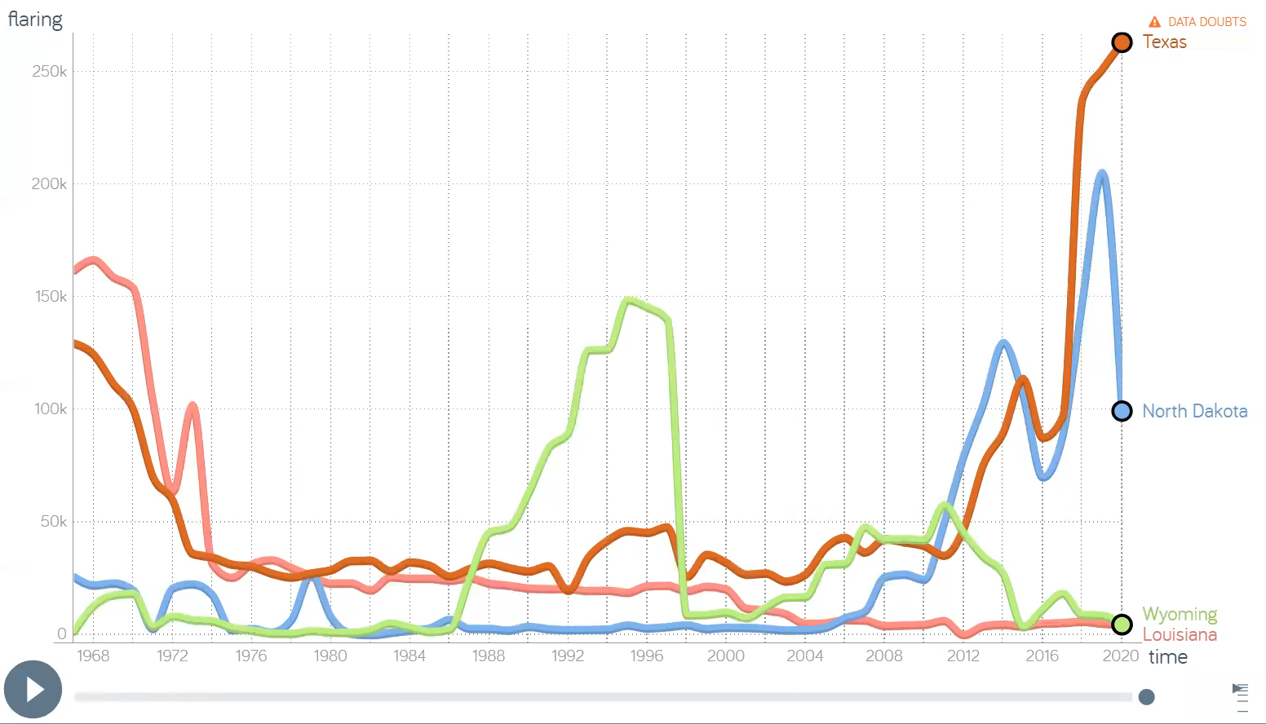
CPTS 575- Data Science| Semester Project Presentation
Used Gap minder software

